Slide 1
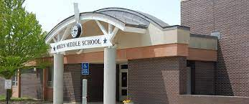
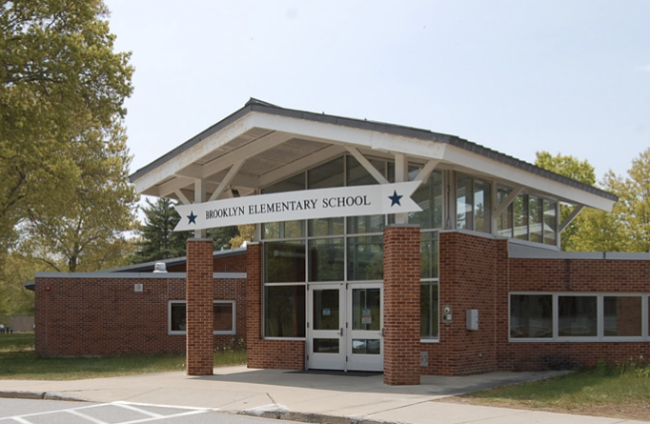
Universal Screen Data
January 2024
Brooklyn Public Schools 2023-2024

Slide 2
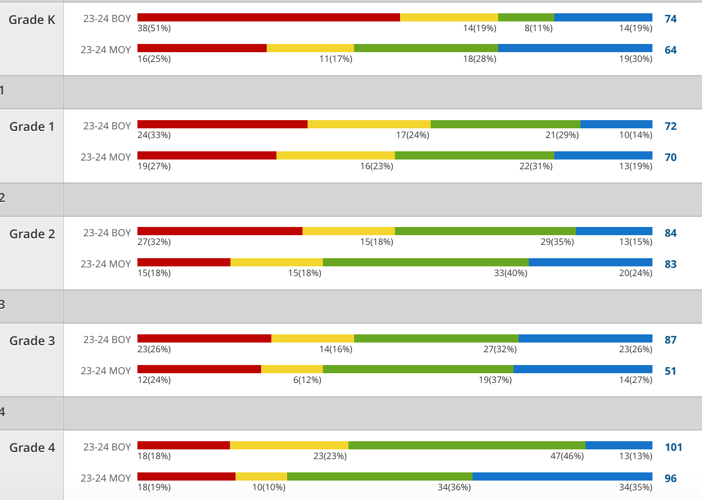
BES DIBELS Composite Scores
Notes:
paula

Slide 3
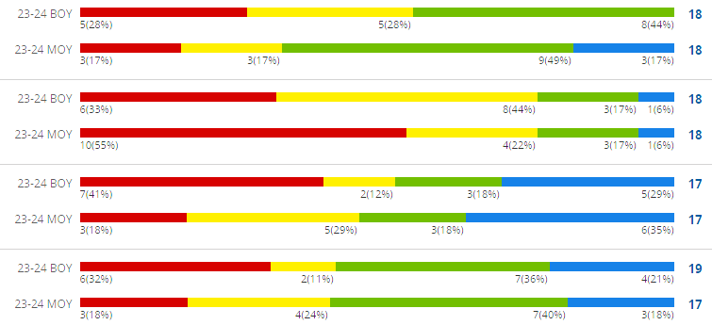
BES DIBELS Composite Scores-Deeper Dive
What’s next?
Notes:
paula

Slide 4
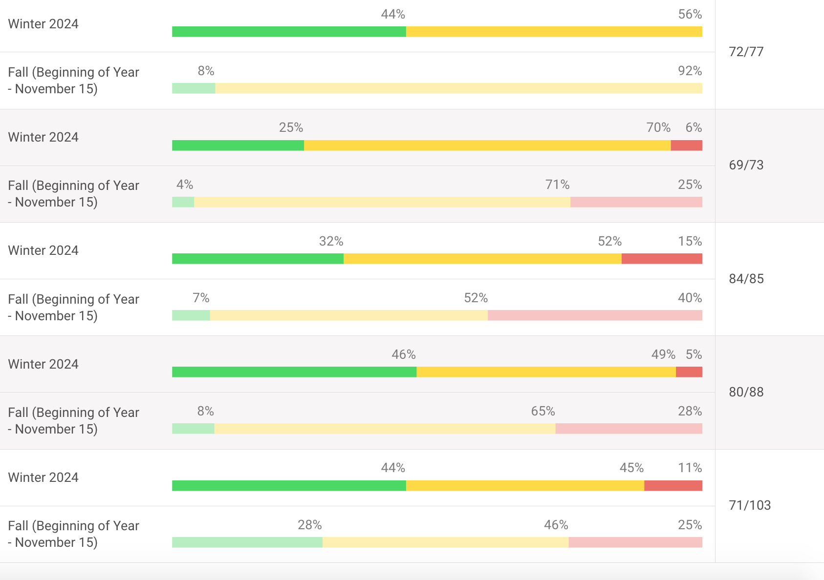
BES iReady Mathematics Diagnostic
K
1
2
3
4
Notes:
Mark

Slide 5
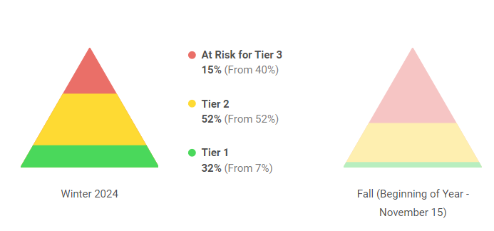
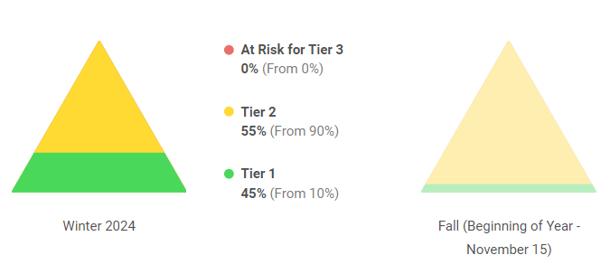
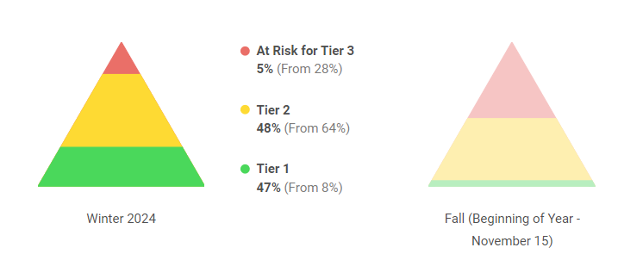
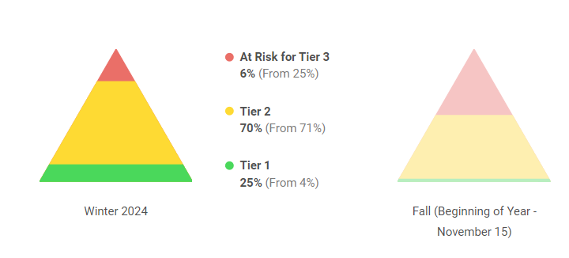
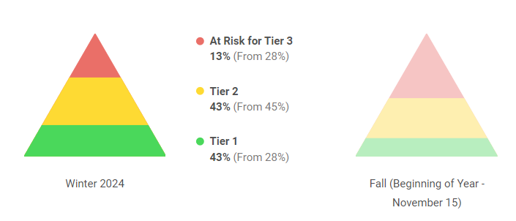
BES iReady Mathematics Diagnostic- Tiers by Grade Level
2
K
84/85
3
73/77
1
83/88
4
69/73
76/103
Notes:
Mark

Slide 6
BMS Benchmark Data STAR
ELA | Fall Prof. | Winter Proficiency | Fall SGP | Winter SGP
Grade 5 | 60 | 58 | 53 | 78
Grade 6 | 61 | 69 | 59 | 61
Grade 7 | 53 | 55 | 53 | 61
Grade 8 | 61 | 64 | 60 | 56
Math | Fall Prof. | Winter Proficiency | Fall SGP | Winter SGP
Grade 5 | 39 | 26 | 38 | 49
Grade 6 | 36 | 38 | 36 | 68
Grade 7 | 41 | 42 | 34 | 64
Grade 8 | 41 | 43 | 44 | 58

Slide 7
BPS DESSA
 | 22/23 DESSA Pre Strength/Typical | 22/23 DESSA Winter Strength/Typical | 22/23 DESSA Spring Strength/Typical | 23/24 DESSA Fall Strength/Typical
Kindergarten | 96% | 99% | 100% | 98%
Grade 1 | 96% | 95% | 93% | 99%
Grade 2 | 86% | 90% | 96% | 87%
Grade 3 | 94% | 94% | 96% | 91%
Grade 4 | 99% | 95% | 95% | 96%
Grade 5 | 88% | 85% | 91% | 95%
Grade 6 | 92% | 82% | 86% | 96%
Grade 7 | 90% | 90% | 92% | 88%
Grade 8 | 93% | 95% | 95% | 97%
Notes:
Can we give an explanation and identify if we find this useful, share lessons YES!!
EdSert

Slide 8
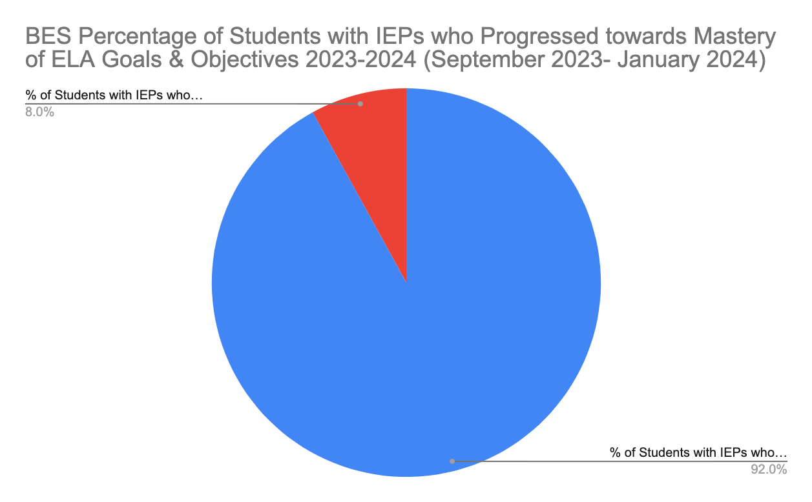
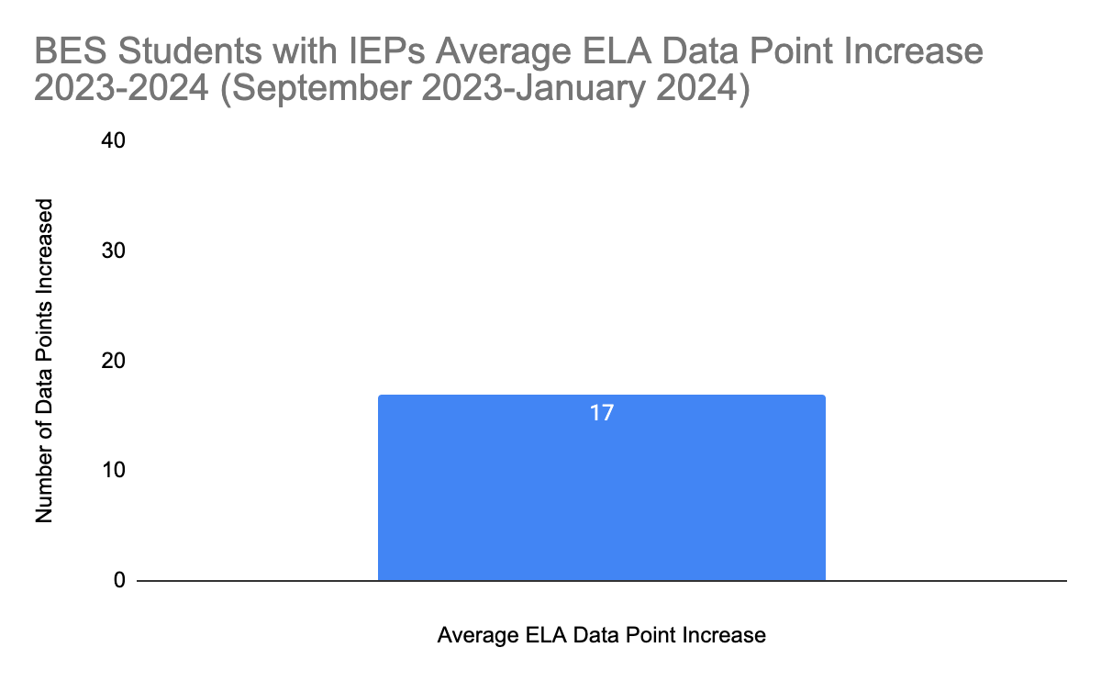
Special Education
BES ELA Goals & Objectives

Slide 9
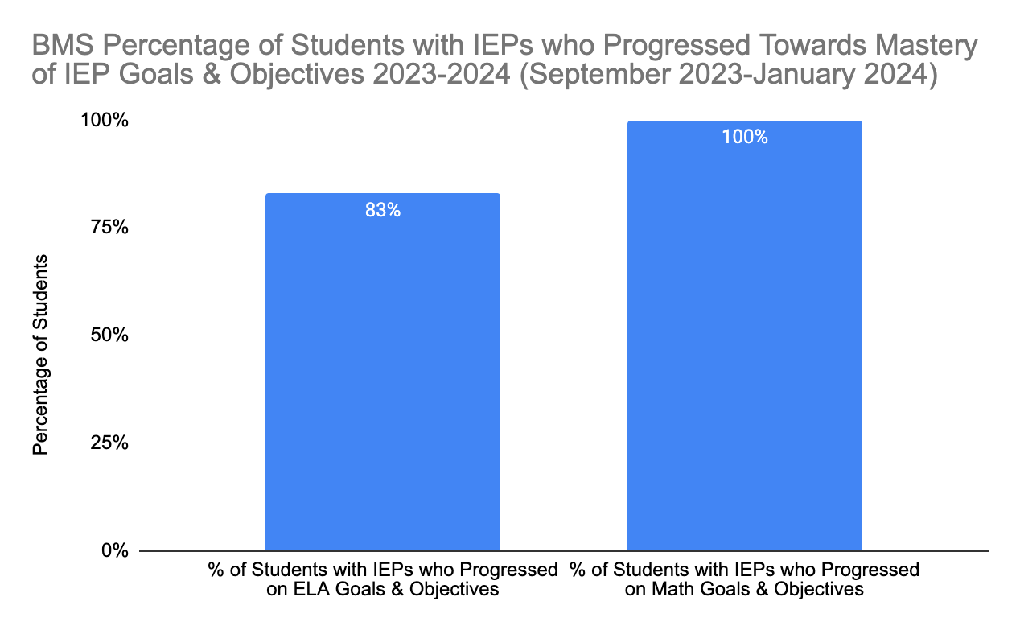
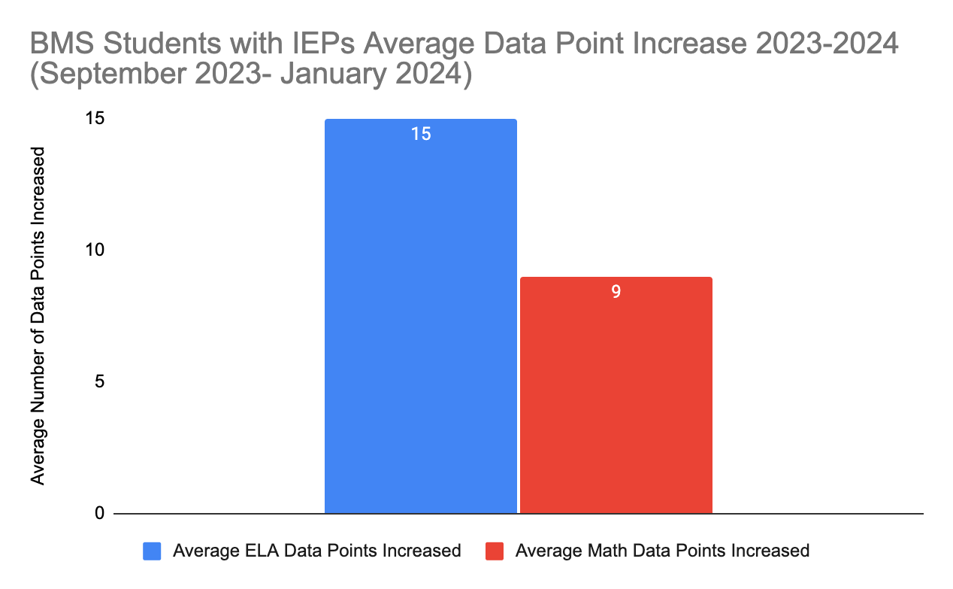
Special Education
BMS ELA & Math Goals & Objectives

